Slide 1
Unique Applicability Case Studies
FTA NATIONAL CONFERENCE
Milwaukee – April 2019

Slide 2
Presenter
Joe Lofgren, Cahill Swift
Senior FTA Auditor and Team Leader
FTA One-Day Seminar Speaker
Other/Past Conference Presentations:
Beginner DAPM
Advanced DAPM
Q&A with the Experts
Collection Site Oversight
Employee Onboarding
Contractor and Employee Coverage

Slide 3
Unique Applicability
Traditional modes
Traditional designs
Traditional coverage
Unique modes
Unique designs
Unique applicability

Slide 4
Coverage in General
Part 655 implemented to “establish programs… designed to help prevent accidents, injuries, and fatalities resulting from the misuse of alcohol and use of prohibited drugs by employees who perform safety-sensitive functions.”
Contractor defined as “…a person or organization that provides a safety-sensitive service for a recipient, subrecipient, employer, or operator consistent with a specific understanding or arrangement. The understanding can be a written contract or an informal arrangement that reflects an ongoing relationship between the parties.”

Slide 5
Coverage in General cont.
Key Considerations:
Employer Applicability:
Public transportation service?
Financial assistance under 49 U.S.C. sections 5307, 5309, or 5311 (or 5339)?
Who provides public transportation services?
Stand in the shoes?
SSE Coverage:
Are employees actually performing covered functions?
Any covered employees who don’t actually perform covered functions?

Slide 6
Types of Applicability
Direct Grantee
State Recipient
Sub-recipient
Pass-through Grantee
Contractor

Slide 7
Public Transportation Modes
Traditional
Unique
Bus
Heavy Rail
Demand Response
Taxi
Light Rail
Bus Rapid Transit
Aerial Tramway
Ferryboat
Inclined Plane
Publico
Cable Car
Monorail

Slide 8
Case Studies
Unique Coverage and Modal Scenarios

Slide 9
Prologue: Average System
Medium-size US (mainland) statistical area
Direct FTA Grantee
5307
5309
0-2 SS Contractors
Demand Response
Maintenance
FR Bus

Slide 10
Applicability: Average System
Grantee’s SS employees are covered
Bus operators
Dispatchers
Supervisors (when performing covered functions)
Some or all of contractors’ employees covered
Operators who provide service for grantee
Maintenance staff who work on transit vehicles
Supervisors (when performing covered functions)
Employees who never provide services to grantee excluded

Slide 11
Case: Taxi Choice
DR Broker
Five taxi contracts
~2000 independent contractors
Patrons use vouchers to choose among the 5 at will

Slide 12
Applicability: Taxi Choice
Two-part Test:
Voucher system
Patron choice
If test passed:
Taxi companies and all operators are exempt from Part 655 requirements
Considerations:
Contractual obligations may not limit patron choice
If only one taxi company, then rule applies

Slide 13
Case: We Bought a Boat!
Traditional Bus Service
Traditional DR Service
Shiny New Ferryboat

Slide 14
Applicability: We Bought a Boat!
Employees of traditional services subject per usual:
Drugs under Part 655
Alcohol under Part 655
All testing reported to FTA via MIS
Employees of ferryboat service:
SS designation set by USCG
Employees tested for drugs as required by USCG
Employees tested randomly for alcohol as required by FTA (655)
Count of employees (average count per random selection period) reported to both FTA and USCG MIS
All random alcohol tests reported to FTA MIS
All other tests reported to USCG MIS

Slide 15
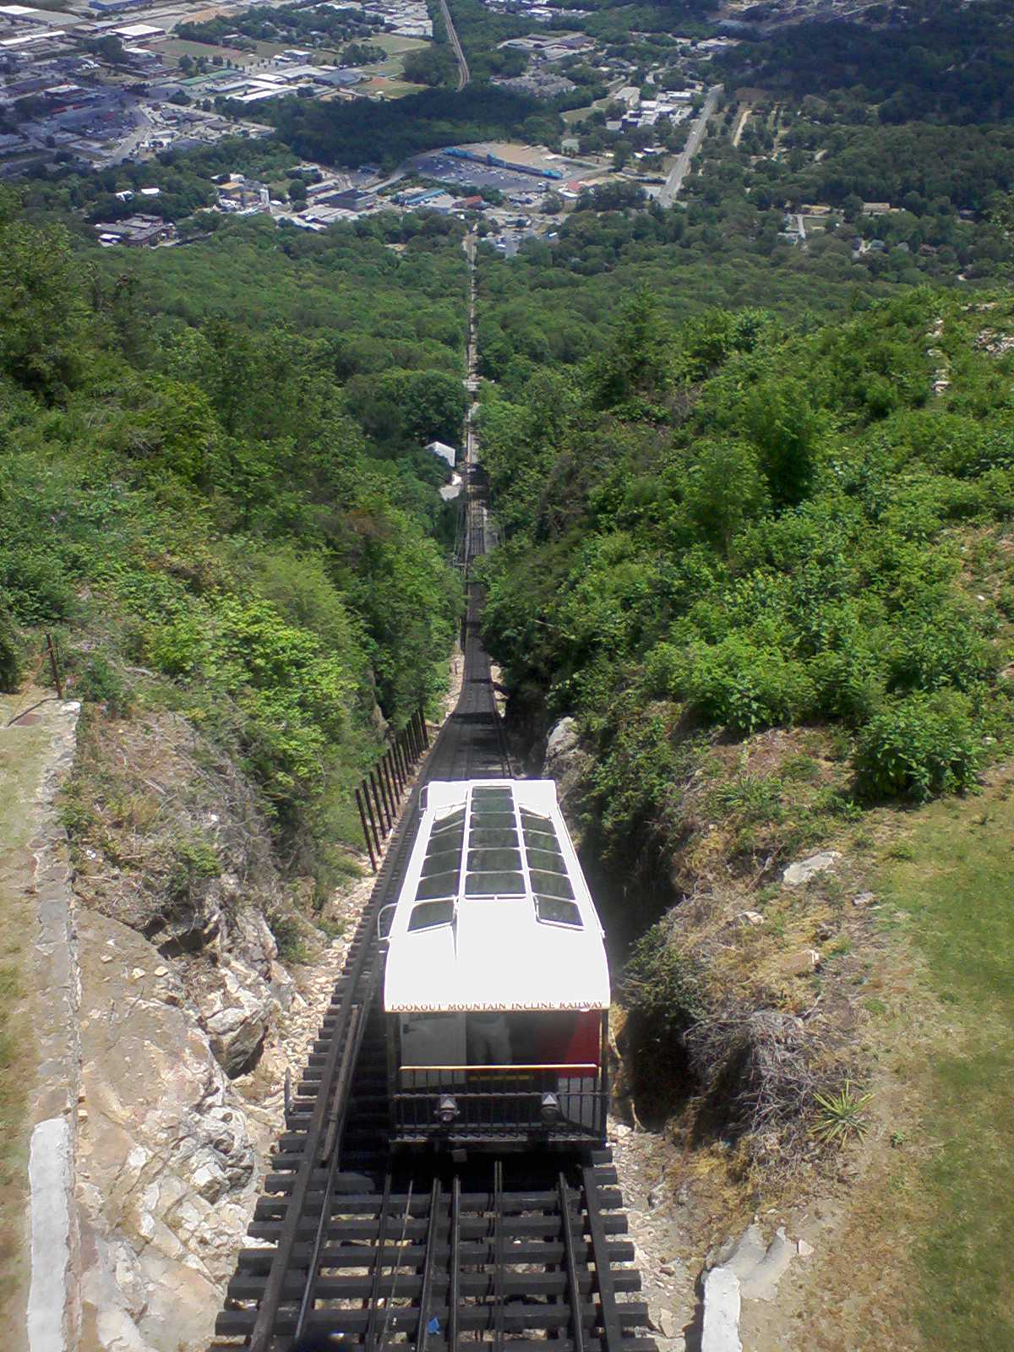
Case: Inclined Plane
Traditional Bus Service
Traditional Light Rail Service
Inclined Plane (Funicular) Service
No on-board operator
Single attendant at station

Slide 16
Applicability: Inclined Plane
Vehicle/system largely automated
Attendant’s duty to activate emergency brake if necessary (stopping car suddenly) = safety-sensitive employee
Maintenance staff also safety-sensitive

Slide 17
Case: Broker-managed Program
Traditional Bus Service
Traditional Light Rail Service
Paratransit through broker
Broker has contracts with three providers
Broker:
Manages policy, training, one random pool
Contracts with service agents (Part 40)
Oversees contractor supervisors (PA, RS, etc.)
Removes contractor employee after violation

Slide 18
Applicability: Broker-managed Program
Broker acting as TPA
Managing random testing pool
Maintaining testing records
Transmitting drug test results to employer
Broker also acting as employer
Making testing decisions (PA/RS)
Receiving alcohol results
Taking action (removal from duty)
Broker may not do both

Slide 19
Case: Dangerous Jobs
Large System
Numerous traditional and non-traditional services spread across large city
Dozens (and dozens) of covered job functions
Includes as safety-sensitive, job duties requiring:
Work high above ground
Work with electrified third-rail
Work with hazardous chemicals

Slide 20
Applicability: Dangerous Jobs
These activities may indeed be dangerous to the employee
OTETA enacted to protect traveling public, not individual employees
Must be removed from pool…
…however, many of these will already be in other covered categories (e.g., vehicle/equipment maintenance)

Slide 21
Case: Publicos
Non-traditional Bus/Van Service
Numerous permit holders
Fixed route, but…
No fixed service interval

Slide 22
Applicability: Publicos
Subsidized shared taxi service
No control over trips
No scheduling
Vendor chosen by passenger/randomly
Part 655 does not apply

Slide 23
Case: Aerial Tramway
Traditional Bus
Vanpool
Aerial Tramway
No operators on individual TR cars

Slide 24
Applicability: Aerial Tramway
Similar to Inclined Plane
Operators who assist traveling public in boarding/alighting may be covered
Operators who engage/stop cars covered
Maintenance personnel covered

Slide 25
Case: Las Vegas Monorail
Public Transportation System
~5 million trips/year (2017 NTD)
24 directly-operated monorail vehicles

Slide 26
Applicability: Las Vegas Monorail
Receives no relevant federal assistance
No § 5307
No § 5309
No § 5311
No § 5339
49 CFR Part 655 does not apply
Some other monorail systems are covered
May have operators
May have dispatch/maintenance staff only

Slide 27
Case: Far Far Away
Traditional Bus System
Traditional Demand Response
May not have CDLs
No SAP(s)…. anywhere

Slide 28
Applicability: Far Far Away
Part 655 still applies
Part 40 still applies
Covered employees who violate Rule must complete Subpart O (SAP/RTD) process before returning to duty
May mean multi-hour flight to mainland/other location

Slide 29
Case: State-managed Program
Similar to Broker-managed Program
State:
Provides policy template to sub-recipients
Provides training resources/direct training (e.g., RS)
Provides decision-making advice
Manages random testing pool (consortium)
Maintains service agent contracts
State does not:
Transmit results to individual sub-recipients
Make testing decisions
Remove employees from duty

Slide 30
Applicability: State-managed Program
Is this a compliant arrangement?
Yes:
State is acting as TPA, but not employer:
Not intercepting alcohol results
Not making testing decisions
Not removing employees from duty
These are “non-delegable” duties of the actual employer of record (§ 40.355)

Slide 31
Key Takeaways
Who is providing public transportation services?

Slide 32
Takeaways
U.S. Public Transportation comes in many shapes and sizes!
Don’t assume your emps are/are not covered – review actual facts and circumstances
Employer standing in shoes of grantee?
Employee performing functions covered by Part 655?
Numerous FTA Drug & Alcohol Updates newsletters may be reviewed at https://www.transit.dot.gov/drug-alcohol-program

Slide 33
Questions?

Slide 34
Thank you

